Slide 1

Title: Student Internship Management System
Team Members:
Venkata Shashankar Chennu
Sai Krishna Gadde
Manikanta Arumilli
Anusha Poreddy
Parimalla Pokuri
Client & Mentor: Dr. Chandra Mouli Kotteti
Sec No: 03
Team No: 04
Presenter: Venkata Shashank Chennu
Page: 1

Slide 2







TEAM - 04
TEAM-04
VENKATA SHASHANKAR CHENNU
SAI KRISHNA GADEE
MANIKANTA ARUMILLI
ANUSHA POREDDY
SHASHANKAR CHENNU
PARIMALLA POKURI
SAI KRISHNA GADDE
MANIKANTA ARUMILLI
Mentor & Client
Dr. CHANDRA MOULI MADHAV KOTTETI
ANUSHA POREDDY
PARIMALLA POKURI
Dr.CHANDRA MOULI KOTTETI
Client & Mentor
Page: 2
Presenter: Venkata Shashank Chennu
Page: 2

Slide 3
Table of Contents
Introduction
Languages Used
JavaScript
Node.JS
Express.JS
MongoDB
DynamoDB
Lessons Learnt
Summary
Presenter: Venkata Shashank Chennu
Page: 3

Slide 4
Why SIMS
The Student internship management system (SIMS) is a fundamental fragment of communication between students, educational institutions and Companies (S-E-A).
Internships are beneficial because they improve your professional aptitude, boost your character, and open up more opportunities.
By investing in internships, you'll give yourself the broadest spectrum of opportunity when seeking and applying for a job after college.
Presenter: VenkataShashank Chennu
Page: 4

Slide 5
Introduction To Application
Student Internship Management System is a Web-based application that serves as a link between students and employers.
Students can look for employment and submit applications.
Companies can assess the student applications, accept or There is an Administrator who has the authority to prevent the bogus data from being generated by either students or businesses.
Companies can access the student applications, accept or reject the application and then recruit the applicants.
Presenter: VenkataShashank Chennu
Page: 5

Slide 6
Introduction Cont’d
User friendly interface.
Easily accessible.
Easy modification.
Provide best security.
Time saving.
Easy to operate and work with.
Presenter: Venkata Shashank Chennu
Page: 6

Slide 7
Languages Used
Front End: HTML,CSS and JS
Back End Technology: Node.js, Express.js
Database: MongoDB and Robot 3T
Presenter: VenkataShashank Chennu
Page: 7

Slide 8
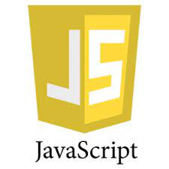
What Is JavaScript
JavaScript is one the core technologies of the world wide web.
JavaScript is a high-level language and often just-in-time complied language.
It has first-class functions.
It has application programming interfaces (APIs) for working with text, dates, regular expressions, standard data structures, and the Document Object Model (DOM)
Fig: 1 Java script Icon
Presenter: VenkataShashank Chennu
Page: 8

Slide 9
What is JavaScript Cont’d
JavaScript can update and change both HTML and CSS.
JavaScript is used to create dynamic and interactive web content like applications and browsers.
Presenter: Venkata Shashank Chennu
Page: 9

Slide 10
Why JavaScript For Web Application:
Various JavaScript frameworks are used for developing and building robust web applications.
This is powered by JavaScript, which interacts with the browser without communicating with the servers.
Popular JavaScript front-end frameworks that help build web apps are Node.js
Presenter: Venkata Shashank Chennu
Page: 10

Slide 11

What is Node.js
Node.JS is a open source development platform for executing JavaScript code server-side.
Node.JS also provides a rich library of various JavaScript modules which simplifies the development of web applications using Node.js to a great extent
Node.js= Runtime Environment + JavaScript Library
Fig 2.1 : Node.js Icon
Presenter:Sai Krishna Gadde
Page: 11

Slide 12
Why Node.js
Node.js is primarily used for non-blocking event –driven servers due its single – threaded nature.
It's used for traditional web sites and back-end API services.
It also real-time communication support.
Fig 2.2 :Node.js Icon
Presenter:Sai Krishna Gadde
Page: 12

Slide 13
Where To Use Node.js
Following are the areas where Node.js is proving itself as a perfect technology partner:
I/O bound Applications
Data Streaming Application
Data Intensive Real-time Applications (DIRT)
JSON APIs based Applications
Presenter:Sai Krishna Gadde
Page: 13

Slide 14
What Is Express.js
Express.js is a free and open-source web application framework for node.js.
It is used for designing and building web applications quickly and easily.
Express.js require only java script, it becomes easier for programmers and developers to build web applications and API.
Presenter:Sai Krishna Gadde
Page: 14

Slide 15
Why Express.js
Express.js supports java script which is widely used language and is also supported everywhere.
With the help of Express.js we can easily build different kind of web applications in short period of time.
Express.js can reduce the coding time by half and still help us build efficient web applications.
Presenter :Sai Krishna Gadde
Page: 15

Slide 16
What Is MongoDB
MongoDB is a open source , document-oriented database designed with both scalability and developer agility in mind.
Instead of storing your data in tables and rows as you would with a relational database , in MongoDB you store JSON-like documents with dynamic schemas.
Built for speed and Full index support for high performance.
Presenter: Manikanta Arumilli
Page: 16

Slide 17
Why MongoDB
MongoDB stores documents or objects
Now a days everyone works with objects (python , java , etc).
Queries will typically be faster with MongoDB
Presenter: Manikanta Arumilli
Page: 17

Slide 18
What Is MongoDB Great For
RDBMS replacements for web applications.
Semi- Structured content management
Real time analytics and high speed logging.
Catching and high scalability.
Presenter: Manikanta Arumilli
Page: 18

Slide 19
Not Great For
Problems requiring SQL.
Highly transactional applications.
Limited Data Sharing and Nesting.
High Memory Storage.
Presenter: Manikanta Arumilli
Page: 19

Slide 20
Advantages
Full cloud-based developer data platform.
Power full querying and analytics.
Easy horizontal scale-out with sharding.
Change - friendly design.
High performance.
Easy installation.
Presenter: Manikanta Arumilli
Page: 20

Slide 21
Disadvantages
Joins not supported.
High memory storage.
Limited Data Size.
Limited Nesting.
Presenter: Manikanta Arumilli
Page: 21

Slide 22
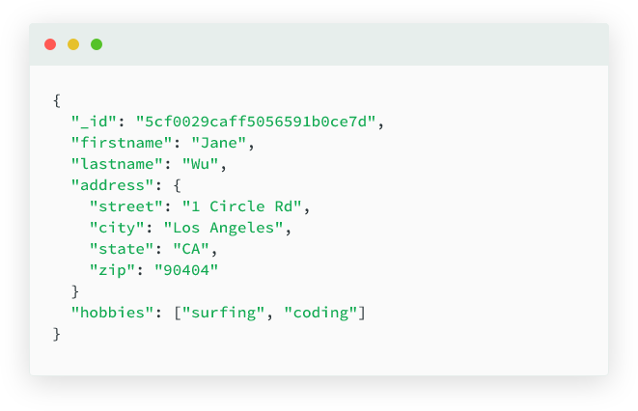
How The Data Will Be Stored
Fig 3: database image.
Presenter: Manikanta Arumilli
Page: 22

Slide 23

DynamoDB
What is DynamoDB.
When it is used.
Factors need to be considered to choose best one.
Fig4:DynamoDB Icon
Presenter: Anusha Poreddy
Page: 23

Slide 24
What is DynamoDB
DynamoDB is a hosted NoSQL database offered by Amazon Web Services (AWS). It offers:
Reliable performance even as it scales;
A managed experience, so you won't be SSH-ing into servers to upgrade the crypto libraries;
A small, simple API allowing for simple key-value access as well as more advanced query patterns.
It provides high throughput at low latency.
It offers structured, unstructured data including JSON documents
Presenter: Anusha Poreddy
Page: 24

Slide 25
When to Use DynamoDB
When key-value or simple queries are present.
When a very high read/write rate is needed.
When auto-sharding is required.
When auto-scaling is required.
When low latency is required.
When high durability is required.
When there is no size or throughput limit.
When there is no tuning.
Presenter: Anusha Poreddy
Page: 25

Slide 26
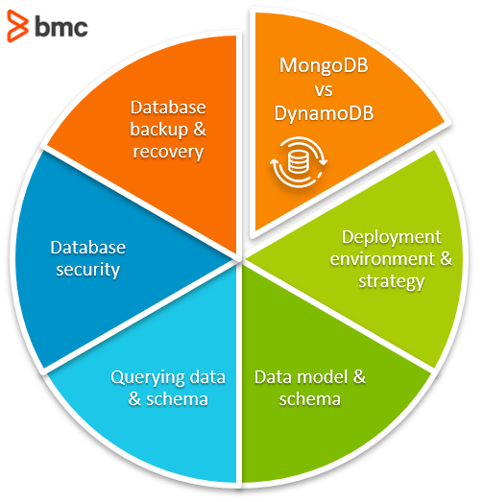
Factors To Be Consider
Both MongoDB and DynamoDB offer similar functionality and feature sets. However, there are some key differentiating factors when it comes to selecting between these two.
Fig5: Factors to be considered
Presenter: Anusha Poreddy
Page: 26

Slide 27
Lessons Learnt
As we are using Robot 3T for the first time, we have faced a issue as the webpage was not connecting to database.
We are also facing a trouble while sending request through the router in java script. Later we have watched several videos in youtube and referred websites to get rid of it .
While we were working on the company page, How to advertise jobs is a big task. Even though we have posted in company page, Job Details were not displaying in Student page. Later we overcome that one too.
Presenter: Parimalla Pokuri
Page: 27

Slide 28
Summary
The main objective of our project is to provide Jobs or Internships for the Students through the help of the website, Company can able to accept Student’s Job applications.
As we are working on this project, We have learnt so many technical things and our perspective towards project has been Improved.
Github link : https://github.com/anushaporeddy030697/student_internship_management
Presenter: Parimalla Pokuri
Page: 28

Slide 29

Thank You
Presenter: Parimalla Pokuri
Page: 29

Slide 30

Presenter: Parimalla Pokuri
Page: 30

Slide 31
TEAM - 04
TEAM-04
VENKATA SHASHANKAR CHENNU
SAI KRISHNA GADEE
MANIKANTA ARUMILLI
ANUSHA POREDDY
SHASHANKAR CHENNU
PARIMALLA POKURI
SAI KRISHNA GADDE
MANIKANTA ARUMILLI
Mentor & Client
Dr. CHANDRA MOULI MADHAV KOTTETI
ANUSHA POREDDY
PARIMALLA POKURI
Dr.CHANDRA MOULI KOTTETI
Client & Mentor
Page: 2
Presenter: Parimalla Pokuri
Page: 31

Slide 32
STUDENT INTERNSHIP MANAGEMENT SYSTEM
Presenter: Parimalla Pokuri
Page: 32

